Slide 1
Introduction to Programming and the world of python
What is Programming Language ?
Programming Language is a set of rules that provides a way of telling a computer, what actions can perform next.
In other words it’s a high level language by which user can interact with computers.
High level language
(Python)
Assembly language
Machine Language
Computer hardware

Slide 2

Why Python?
Python is a high-level, interpreted, interactive and object-oriented scripting language. It is designed to be highly readable. It uses English keywords frequently where as other languages use punctuation and it has fewer syntactical constructions than other languages.
Nowadays python is used in AI And Machine Learning which makes it as an on-demand skill for 2020.
Characteristics of Python :
Python is Interepted
Python is Interactive
Python is Object-Oriented
Python is a Beginner's Language
It supports automatic garbage collection.
Applications of Python:
Easy-to-read
Easy-to-maintain
A broad standard library
Interactive Mode
Portable
Scalable

Slide 3
Installation
On Windows:
Download python installer from browser and install it in your system
https://www.python.org/downloads/
On Mac:
https://www.python.org/downloads/mac-osx/
On Linux:
For Fedora 23 and above Python3 is in the system by default.
For Fedora 22 and below.
[user@host]$ sudo yum install python3
From epel7 (RHEL7, CentOS7, SL7).
[user@host]$ sudo yum install python34
For Debian
[user@host]$ sudo apt-get install python3

Slide 4
Overview
Python Interpreter:
Python is an interpreter language, so you can write the code into the Python interpreter directly or you can write the code in a file and then run the file.
Set an environment variable to run python commands from CMD in Windows.
Python
Python –version to see the version
Run as a Source file:
As a programmer, you might want to write the above code into a source file. Use any text editor you like to create the file called "fileName.py". '.py' is an executable file extension for python.
Open notepad and type print("Hello World!") and save it as hello.py
To Execute the file, open CMD and redirect to the file location and then type Python hello.py
To run the code first you have to make the file executable. In GNU/Linux you can do this by typing the following command in a shell or terminal:
$ chmod +x helloworld.py Now you can type the filename and it will run:
$ ./helloworld.py Hello World!

Slide 5
Overview
Whitespaces and Indentation:
In python Whitesapces are very important. Whitespace in the beginning of the line is known as indentation, but if you give wrong indentation it will throw an error.
Example:
>>> a = 12
>>> a = 12
File "<stdin>", line 1 a = 12 ^ IndentationError: unexpected indent
Refer https://docs.python.org/2.0/ref/indentation.html for more detailed study
Comments lines:
Comments can be used to explain Python code.
Comments can be used to make the code more readable.
Comments can be used to prevent execution when testing code.
There are three types of comments single line comment, Inline comments, and document comments

Slide 6
Overview
Single line comments:
>>> # This is a comment >>> # The next line will add two numbers >>> a = 12 + 34
Inline Comments:
>>> a = 12 + 34 # The next line will add two numbers
Doc Comments:
"""The next line will add two numbers and this is the comment is used as an example for doc comments
"""
>>>a = 12 + 34
Modules:
Modules are Python files that contain different function definitions or variables that can be reused. Module files should always end with a .py extension. Python itself has a vast module library with the default installation. We will use some of them later. To use a module you have to import it first.
>>> import math >>> print(math.e) 2.71828182846

Slide 7
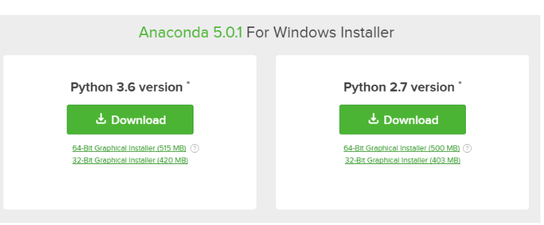
Instaling Anaconda
Visit Anaconda.com/downloads
Select Windows
Download the .exe installer
Open and run the .exe installer
Open the Anaconda Prompt and run some Python code
Open Jupyter notebooks and Spyder to execute or Interact with python

Slide 8
This chapter is about Python data types. Python has many built-in data types such as integers, floats, booleans, strings, and lists.
By the end of this chapter you will be able to:
Explain the difference between Python's built-in data types
Define variables with the assignment operator =
Create variables with different data types
Use Python's type() function to determine an object's data type
Compare variables with the comparison operator ==
Convert variables from one data type to another
Work with integers, floats and complex numbers
Understand the boolean data type
Variables and Data Types

Slide 9
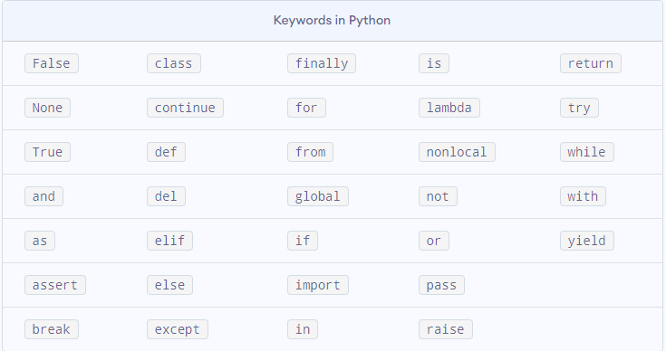
Data Types:
Python has many useful built-in data types. Python variables can store different types of data based on a variable's data type. A variable's data type is created dynamically, without the need to explicitly define a data type when the variable is created.
It is useful for problem solvers to understand a couple of Python's core data types in order to write well-constructed code.
Data types such as integer,float,double,boolean, etc. can dynamically define while initializing the variable.
Use Type() to see the data type of variables.
Keywords and Identifiers:
Keywords are the reserved words in Python.
We cannot use a keyword as a variable name, function name or any other identifier. They are used to define the syntax and structure of the Python language.

Slide 10
Identifiers:
An identifier is a name given to entities like class, functions, variables, etc. It helps to differentiate one entity from another.
Rules for writing identifiers
Identifiers can be a combination of letters in lowercase (a to z) or uppercase (A to Z) or digits (0 to 9) or an underscore _. Names like myClass, var_1 and print_this_to_screen, all are valid example.
An identifier cannot start with a digit. 1variable is invalid, but variable1 is perfectly fine.
Keywords cannot be used as identifiers. >>> global = 1 File "<interactive input>", line 1 global = 1 ^ SyntaxError: invalid syntax
We cannot use special symbols like !, @, #, $, % etc. in our identifier. >>> a@ = 0 File "<interactive input>", line 1 a@ = 0 ^ SyntaxError: invalid syntax
Identifier can be of any length.

Slide 11
Variable Assignment:
A variable is a named location used to store data in the memory. It is helpful to think of variables as a container that holds data which can be changed later throughout programming. For example,
number = 10
Here, we have created a named number. We have assigned value 10 to the variable.
You can think variable as a bag to store books in it and those books can be replaced at any time.
number = 10 number = 1.1
Initially, the value of number was 10. Later it's changed to 1.1.
Note: In Python, we don't assign values to the variables, whereas Python gives the reference of the object (value) to the variable.
Assigning a value to a Variable in Python
As you can see from the above example, you can use the assignment operator = to assign a value to a variable.
Reading Input from Keyboard:
In Python we use input function to do input. input(“String to show”) , this will return a string as output.
Let us write a program to read a number from the keyboard
number = int(input("Enter an integer: "))
Examples:
amount = float(input("Enter amount: ")) inrate = float(input("Enter Interest rate: ")) period = int(input("Enter period: "))

Slide 12
Multiple Assignments in a single line:
You can even assign values to multiple variables in a single line, like
>>> a , b = 45, 54 >>> a 45 >>> b 54
Using this swapping two numbers becomes very easy
>>> a, b = b , a >>> a 54 >>> b 45
Formatting strings:
Python 3, there are a few different ways to format a string. We use these methods to format a text dynamically. I will go though a few examples below.
.format method
This is my preferable way to format strings. Example below:
>>> name = "I" >>> language = "Python" >>> Text= "{0} love {1}.".format(name, language) >>> print(Text) I love Python.

Slide 13
In Python 3.6, we have a new way to do string formatting. PEP 498 introduces the concept called f-strings.
Here is the same example using f-strings:
>>> name = "I" >>> language = "Python" >>> Text= f"{name} loves {language}." >>> print(Text) I love Python.
F-strings provide a simple and readable way to embed Python expressions in a string. Here are a few more examples.
>>> answer = 2 >>> print(f"The answer is {answer}") The answer is 2 >>> import datetime >>> d = datetime.date(2004, 9, 8) >>> f"{d} was a {d:%A}, we started the mailing list back then." '2004-09-08 was a Wednesday, we started the mailing list back then.

